Slide 1

Searching E-job portals in naukri.com
Submitted by:
Name : k.shanmukha priya
Reg no :192011233

Slide 2

Aim: to search naukri.com in e-job portals

Slide 3
Requirement for e-job portals
Internet connection
e-mail ID
LOGIN –user ID\user name
valid password
graduation

Slide 4
Positive test scenario
Enter valid user name.
Enter valid password.
Click on forget password link and forget password page.
Click on create new account button and verify if it takes to new account page.
Select keep the signed in option to retain login session.
Need internt connection ,done only by online.
Need to do work in online from home.
Flexible schedule and work areas.
Increased the productivity.
Spend more time with family.

Slide 5
Negative test scenario
Enter invalid user name and valid password.
Enter valid username and invalid password.
Less reliable internet connection is a problem.
Is concerns on cyber security.
Lacl of /less collaboration.
Not for everyone,only for loneliness.
Fail to login the application.
Enter invalid user name and password.
Keep one field blank either username or password and check login.
Lack of internet connection.

Slide 6
Test cases
Test cases
Type – negative/positive
Test case
Verify if a user will be able to login with valid username and valid password.
Verify if a user cannot login with a valid username and an invalid password.
Verify the login page for both ,when the field is blank and submit button is clicked.
Verify the forget password functionality.
Verify the messages for invalid login.
Verify the remember me functionality.
Verify if the data in password field is either visible as asterisk bullet signs.
verify if a user cannot enter the characters more than the specified range in each field.
Verify the login page against SQL injection attack.
Verify if a user should not be allowed to login with different credentials from the same browser at the same time.
Positive
Negative
Negative
Positive
Positive
Positive
positive
Positive
Negative
Negative

Slide 7
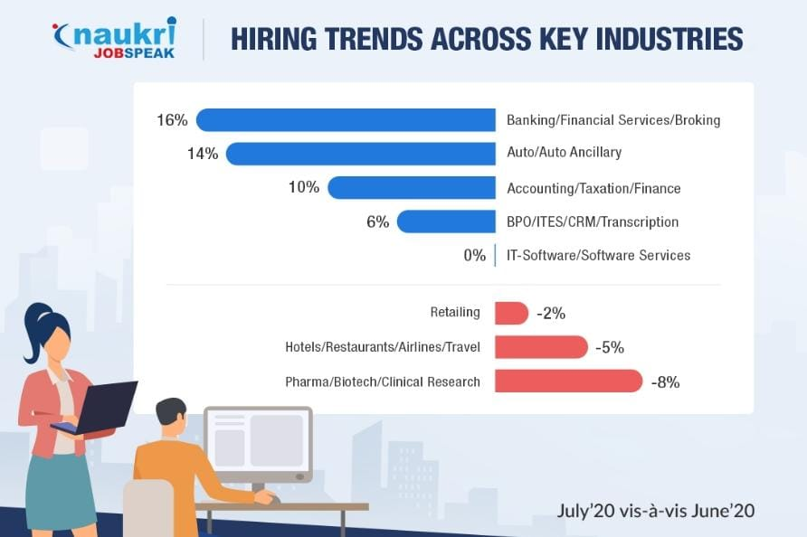


Slide 8
THANK YOU

